Slide 1
<ai/> <IQ/> LABS
Core JAVA

Slide 2
JVM Internals & Memory Model – {Agenda}
JVM Architecture
Class Loading Process
Java Memory Management
Garbage Collection

Slide 3
JVM Architecture
Class Loader
Loads ‘.class’ files into memory.
Runtime Data Area
Method Area: Stores class structures (methods, fields).
Execution Engine
Interpreter: Reads bytecode line by line.
Native Interface
Allows Java to interact with native libraries (e.g., C/C++).
Loading → Linking → Initialization.
====Phases===
Heap: Stores objects.
Stack: Stores method calls and local variables.
PC Register: Tracks current instruction.
Native Method Stack: Supports native (non-Java) code.
JIT Compiler: Converts bytecode into native machine code for performance.
Garbage Collector: Frees memory by removing unreachable objects.

Slide 4
Class Loader – {Code example}
class A {
static { System.out.println("Class A Loaded"); }
}
public class Test {
public static void main(String[] args) {
A obj = new A(); // triggers class loading
}
}
Explanation:
When new A() is executed, the JVM loads class A, links it, and runs the static block.

Slide 5
Garbage Collection
Program Execution
Objects Allocated in memory
GC Root analysis
Unreachable object – (marked)
Memory Reclaimed
Explanation:
GC starts from GC Roots (like stack variables, static references) → marks reachable objects → deletes unreachable ones → frees memory.

Slide 6
Garbage Collection – {Generational Model}
Why Generational GC?
Most objects in Java are short-lived (e.g., temporary strings, local variables).
A few objects are long-lived (e.g., configuration objects, caches).
Instead of scanning the entire heap every time, JVM divides the heap into generations to optimize GC.
Young Generation
Eden Space: New objects are created here.
Survivor Spaces (S0, S1): Objects that survive a GC cycle are copied here.
Minor GC: Cleans Eden frequently (fast, efficient).
Old Generation (Tenured Space)
Long-lived objects promoted from Survivor spaces.
Major/Full GC: Less frequent but more expensive.
Metaspace (Java 8+)
Stores class metadata, method info, static variables.
Replaced PermGen from earlier JVM versions.

Slide 7
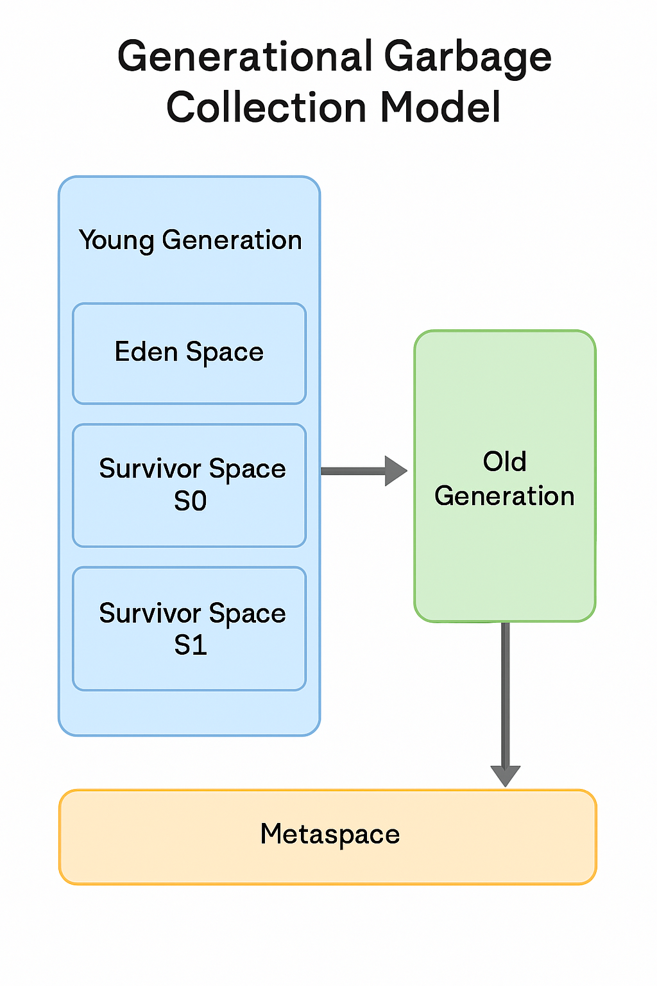
Garbage Collection – {GC Flow}
GC Process Flow
Object Creation: New objects go into Eden Space.
Minor GC:
  Clears Eden.
  Surviving objects → moved to Survivor S0/S1.
Promotion:
  If objects survive multiple Minor GCs, they are
  promoted to Old Generation.
Major GC:
  Cleans Old Generation when it fills up.
  More expensive, may cause application pause.

